Slide 1
Social protection at the crossroads:– towards new social contract

Slide 2
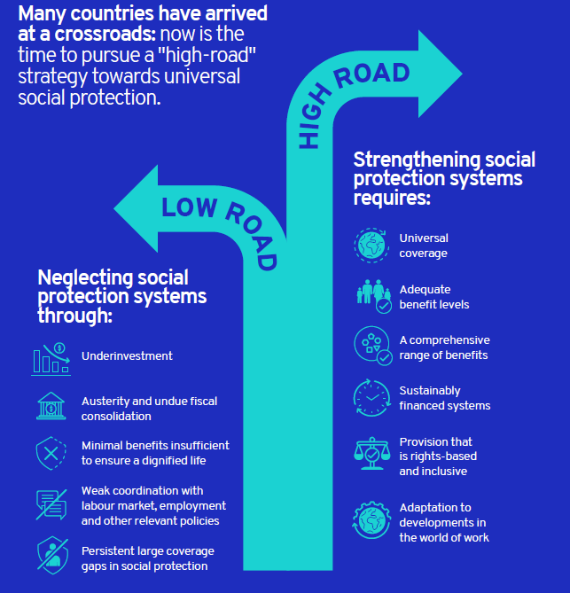
Social protection at the cross-roads: Taking the ‘high road’ towards universal social protection
Social protection has played a key role in the COVID-19 policy response as stabilizer to protect people’s health, jobs and incomes.
Unique policy window for making the right choices regarding the future of their social protection systems.
“high-road” strategy of investments in universal social protection systems.
“low-road” approach of minimalist social protection policies and fiscal consolidation.
Universal social protection is at the core of a human-centred recovery, ensuring that workers in all types of employment enjoy adequate and comprehensive social protection, financed in a sustainable and equitable way based on solidarity.

Slide 3
The historical trend is unmistakably positive
Development of social protection programmes anchored in national legislation by policy area, pre-1900 to 2020 (percentage of countries)
COVID-19 has temporarily expanded provision, but what have been the long-term coverage trends?
The development of social protection systems over the past 120 years has been remarkable.
Most countries have schemes in place, anchored in national legislation, covering most areas of social protection.
However, the extension of effective coverage has lagged significantly behind that of legal coverage.

Slide 4
Overview of effective coverage across the lifecycle (SDG 1.3)

Slide 5
Guaranteeing social protection for children

Slide 6
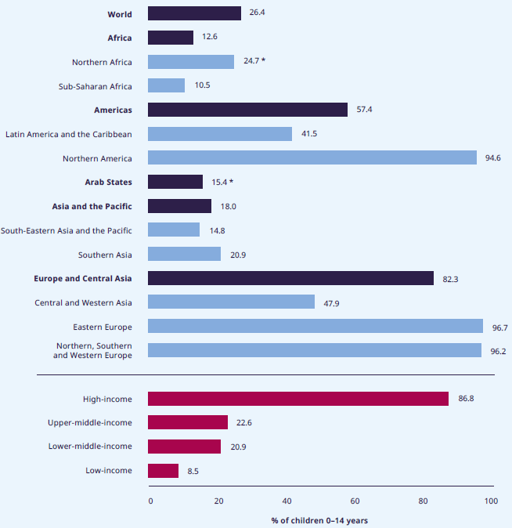
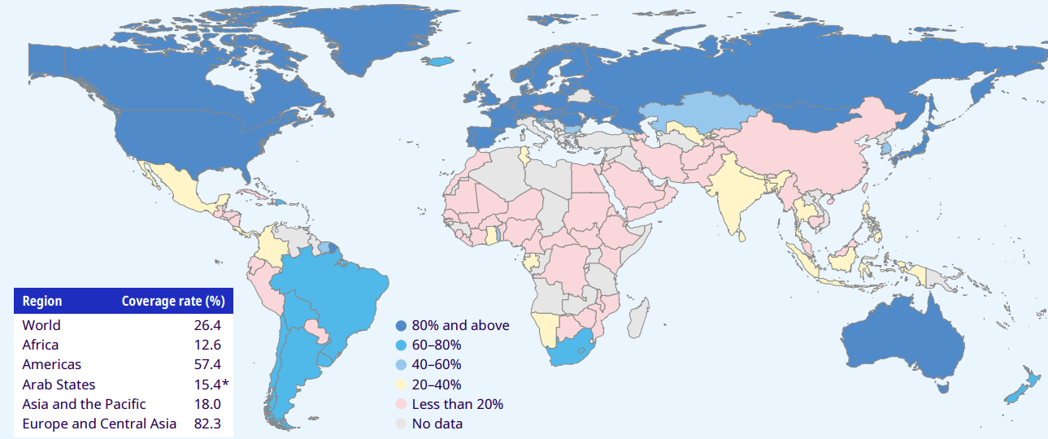
Social protection for children remains limited, yet is critical for unlocking their potential
SDG indicator 1.3.1 on effective coverage for children and families: % of children 0–14 years receiving child or family cash benefits, by region, subregion and income level, 2020 or latest available year
Social protection systems are an essential for realizing children’s rights.
Children are twice as likely to live in poverty as adults. Pre-COVID-19: one in six, or 356 million – were living in extreme poverty.
Most children still have no effective coverage — only 26.4% receive social protection cash benefit.
Staggering regional differences in effective coverage: 82.3% in Europe & Central Asia and 12.6% in Africa.
SDG1.3.1 on effective coverage for children & families: % of children 0–14 years receiving child & family cash benefits, 2020 or latest available year

Slide 7
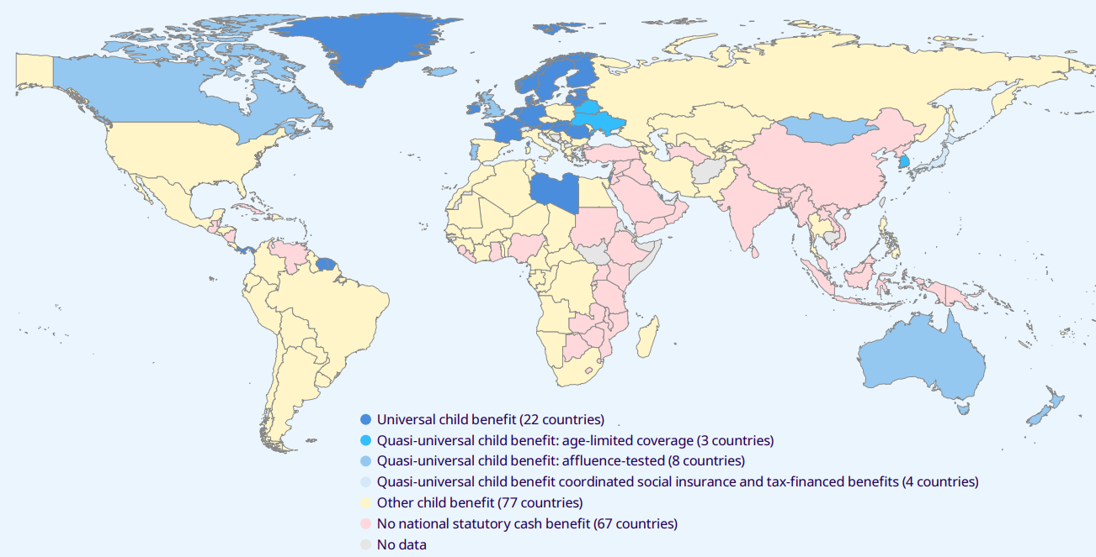
Towards universal social protection for children
Child & family benefits (cash benefits) anchored in law, by type of scheme, 2020 or latest available year
Positive recent developments include the adoption of universal or quasi-universal child benefits (UCBs/qUCBs)
Average national GDP expenditure on social protection for children is too low = only 1.1% of GDP
To address the dramatic increase in child poverty caused by COVID-19 (142 million more in poverty), we must close social protection coverage gaps through an integrated systems approach that also contributes to ensuring access to quality nutrition, care, health care and education.

Slide 8
Ensuring income security in working age

Slide 9
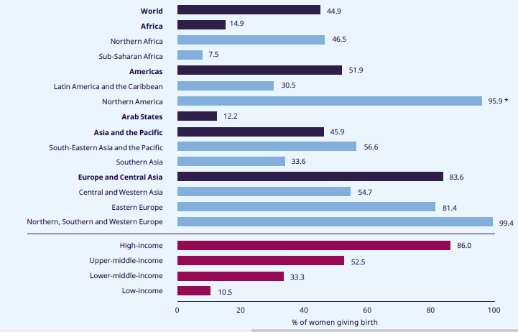
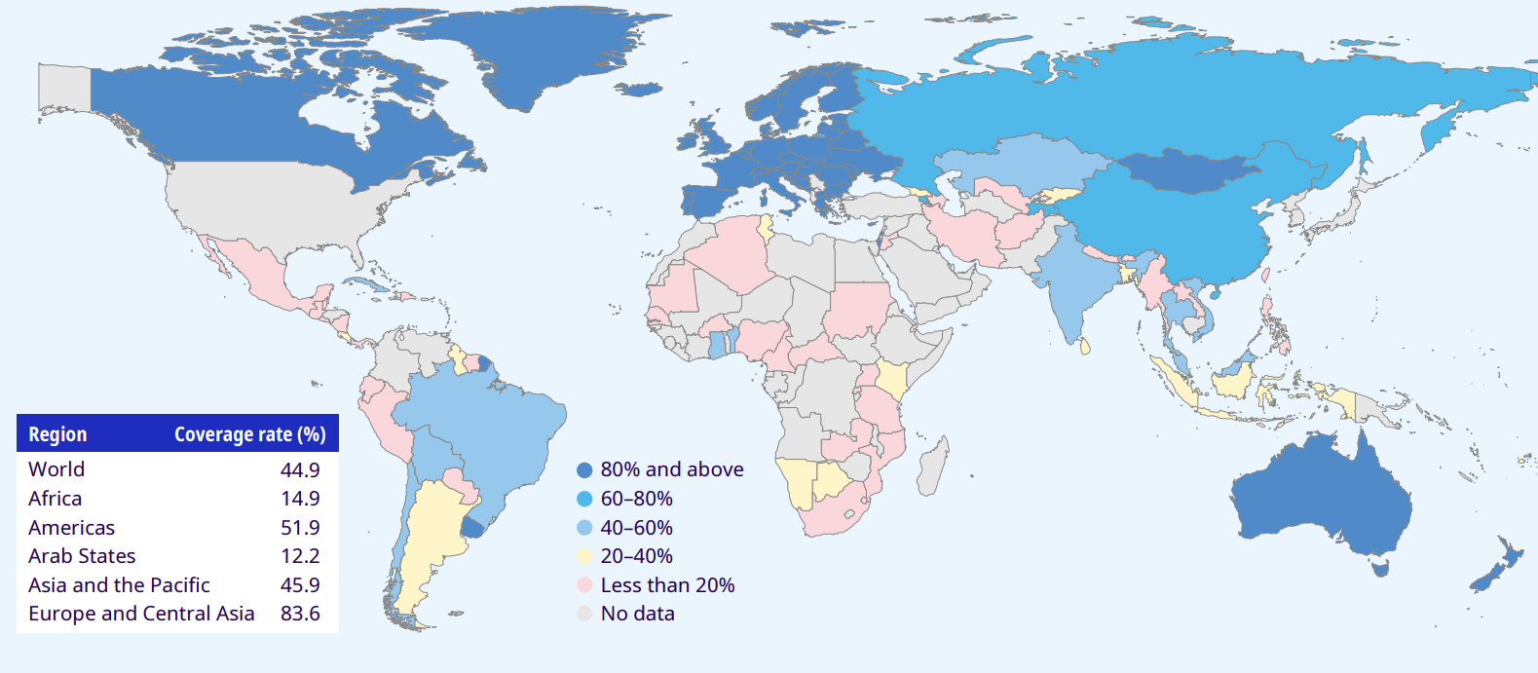
Maternity protection, and paternity and parental leave benefits
SDG 1.3.1 on effective coverage for maternity protection: % of women giving birth receiving maternity cash benefits, by region, subregion and income level, 2020 or latest available year
The pandemic adversely affected childbearing women: increased the risk of employment and livelihood loss and disrupted healthcare systems & other services.
Lack of income security forces many women to keep working into the very late stages of pregnancy and/or to return to work prematurely, thereby increasing health and poverty risks.
Only 44.9% of women with newborns worldwide receive a maternity cash benefit.
Large regional variations: coverage of childbearing women is universal in most of Europe, compared to a mere 7.5% in sub-Saharan Africa, compounded by a lack of affordable access to maternal and new-born healthcare services.
Paid paternity and parental leave promotes gender equity
SDG 1.3.1 on effective coverage for maternity protection: % of women giving birth receiving maternity cash benefits, 2020 or latest available year

Slide 10
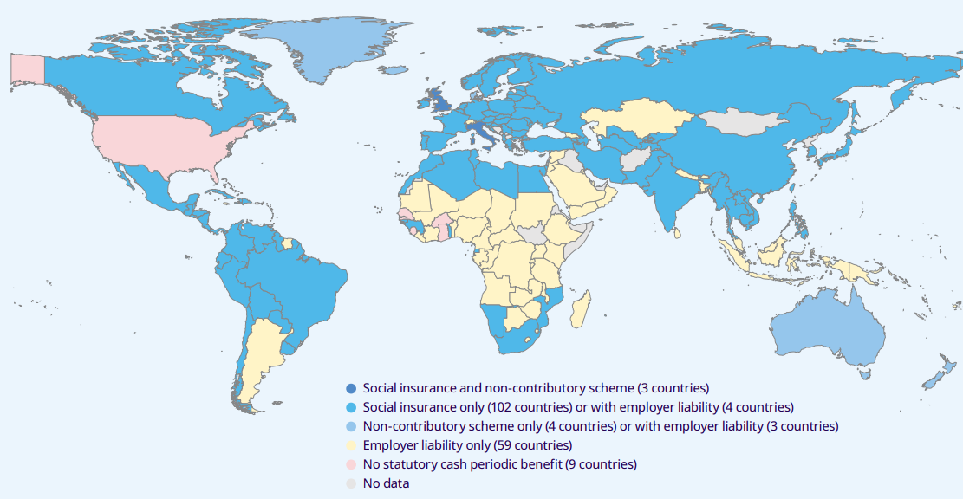
Sickness benefits
COVID‑19 demonstrated the acute importance of income security during ill health, including quarantine.
Only a third of the world’s working-age population have their income security protected by law in case of sickness.
This coverage is not always adequate, as benefit level, duration and eligibility criteria (such as waiting periods) may create gaps in protection.
Many countries provide paid sick leave fully or partially through employers’ liability rather than sickness benefits, which creates additional coverage gaps.
Shortage of data on effective coverage of sickness benefits constrains monitoring under SDG target 1.3.
Evidence on costs incurred by patients when sickness benefits are absent indicates it creates significant poverty risks.
Sickness protection (cash benefits) anchored in law, by type of scheme, 2020 or latest available year

Slide 11
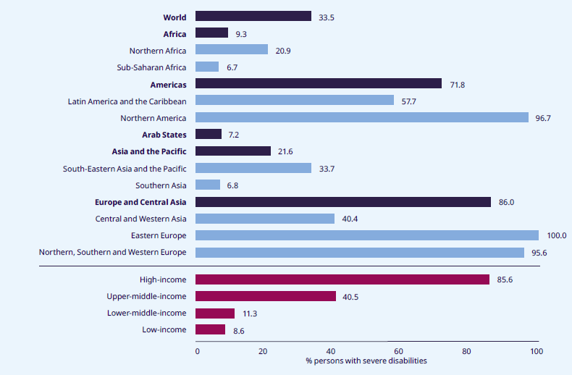
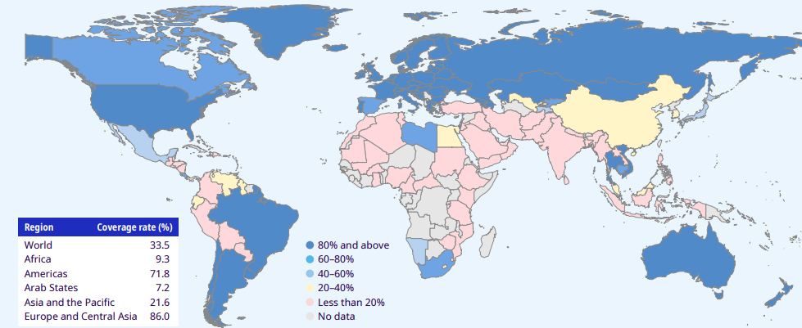
Disability benefits and disability-inclusive social protection
SDG 1.3.1 on effective coverage for disability protection: % of persons with severe disabilities receiving cash benefits, 2020 or latest available year
People with disabilities have been disproportionately affected by COVID‑19, yet only 8.5 % of all announced measures were directed at people with disabilities.
Only 33.5 per cent of people with severe disabilities worldwide receive a disability benefit, with large regional variation: close to universal in Eastern Europe yet in Southern Asia and sub-Saharan Africa less that 7% covered.
Disability-inclusive social protection systems guarantee effective access to healthcare and income security:
a combination of general and disability-specific schemes, both cash and in-kind;
enable people with disabilities to participate actively in education, employment and society.
Collecting better administrative data and household surveys on PWDs is crucially important to facilitate the effective monitoring of social protection systems.

Slide 12
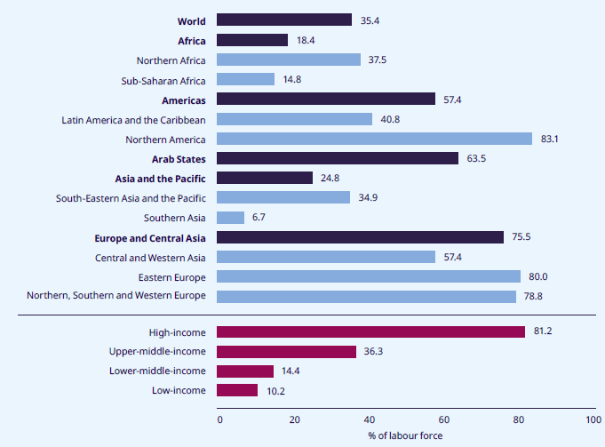
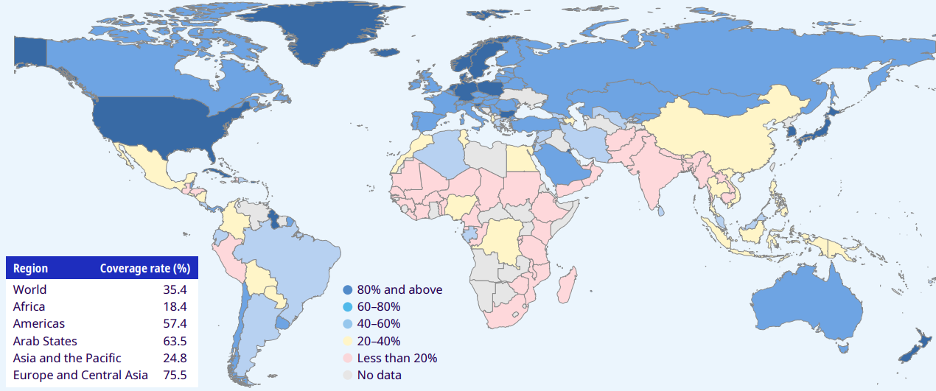
Employment injury protection
SDG 1.3.1 on effective coverage for employment injury protection: % of labour force aged 15+ years covered by cash benefits in case of employment injury (active contributors) 2020 or latest available year
2.78 million deaths a year resulting occupational accidents or work-related disease
This economic burden of poor OSH equates to 3.94% global GDP each year.
Effective coverage of workers by employment injury insurance (EII) is still low worldwide at 35.4%
Many countries have recognized COVID-19 as an occupational injury in order to ensure easier and faster access to associated benefits under the work injury insurance system, in particular for workers in the most exposed sectors.
Extending employment injury protection to workers in the informal economy remains of high importance.

Slide 13
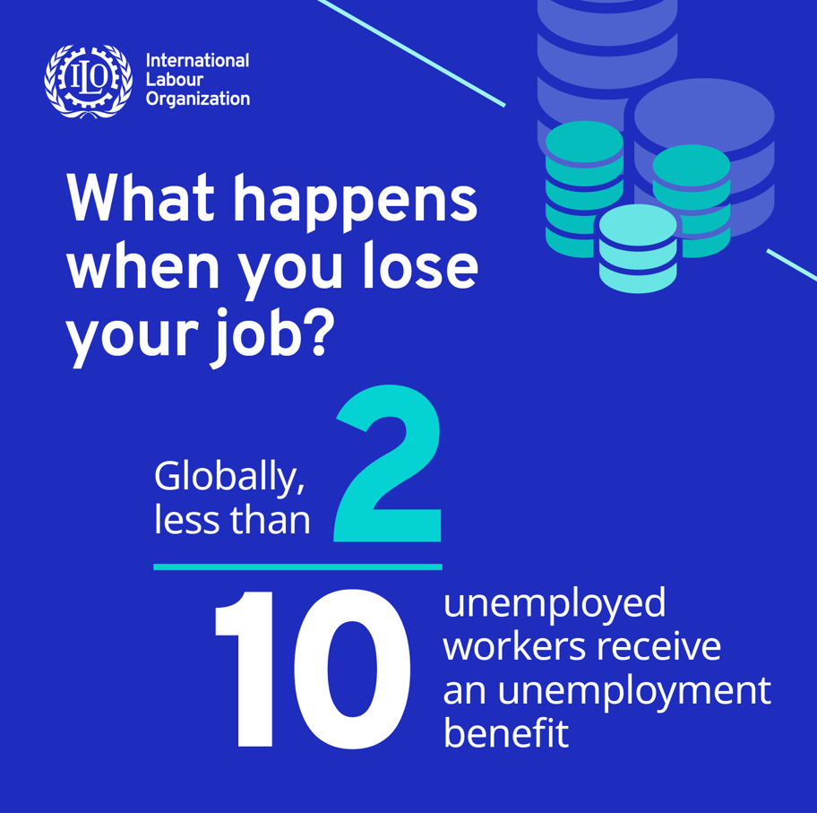
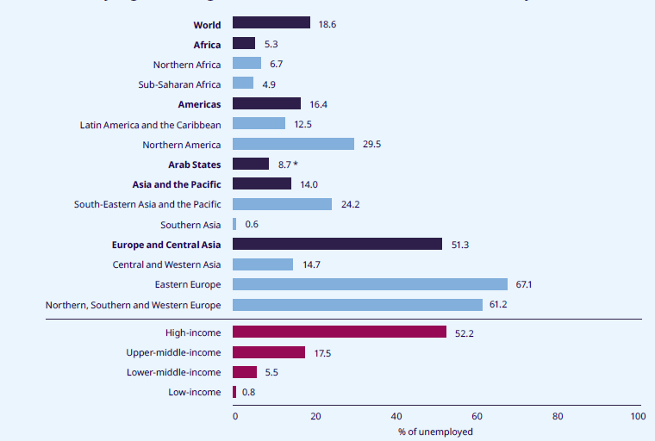
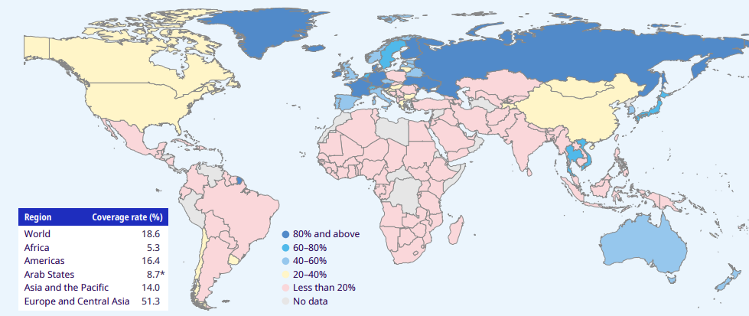
Unemployment protection
SDG 1.3.1 on effective coverage for unemployment protection: % of unemployed persons receiving cash benefits, 2020 or latest available year
COVID‑19 highlighted the crucial role of unemployment protection in
ensuring income security for unemployed workers and their families and, in together with employment services, supporting job search and skills development
preventing unemployment and supporting workers and enterprises through partial unemployment benefits.
stabilizing the economy, stimulating economic recovery and supporting structural economic changes
Unemployment protection programmes are also of paramount importance in supporting people adapt to change (i.e. technological innovations and climate change),
96 countries have established an unemployment protection scheme in law, typically through social insurance mechanisms.
Only 18.6 per cent of unemployed workers worldwide actually receive unemployment benefits, with large regional disparities

Slide 14
Ensuring income security in old age

Slide 15
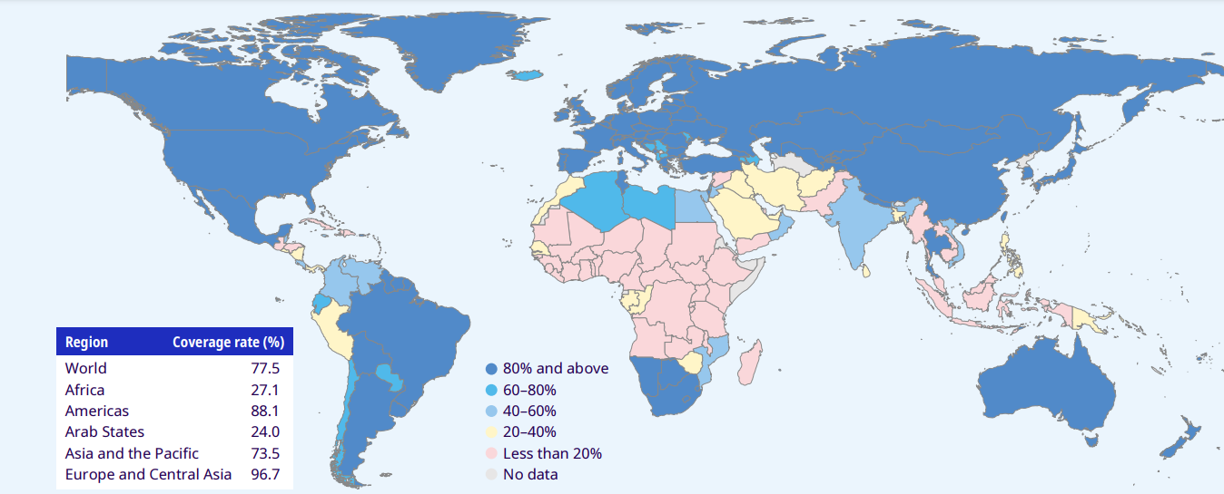
Social protection for older women and men still faces coverage and adequacy challenges
Pensions are the most widespread form of social protection: 77.5% of people above retirement age receive some form of old-age pension, either contributory or non-contributory or both.
Significant progress has been made with respect to extending pensions coverage in developing countries, yet adequacy is often a challenge.
Major disparities remain across regions, between rural and urban areas, and between women and men.
SDG 1.3.1 on effective coverage for old-age protection: % of persons above statutory retirement age receiving an old-age pension, 2020 or latest available year

Slide 16
Ensuring effective access to health care and financial protection through social health protection

Slide 17
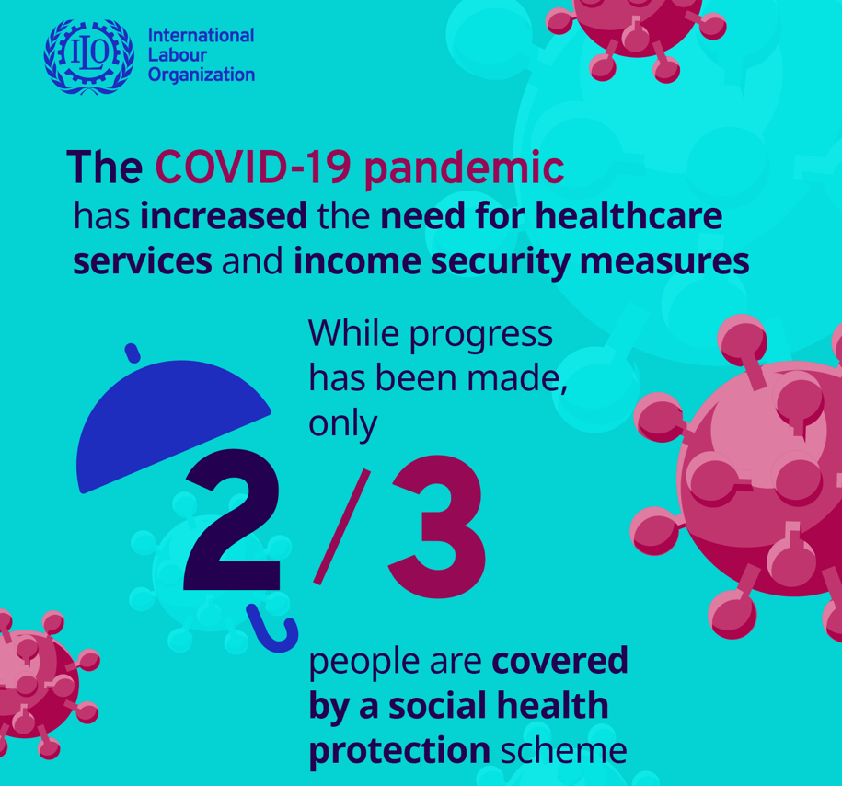
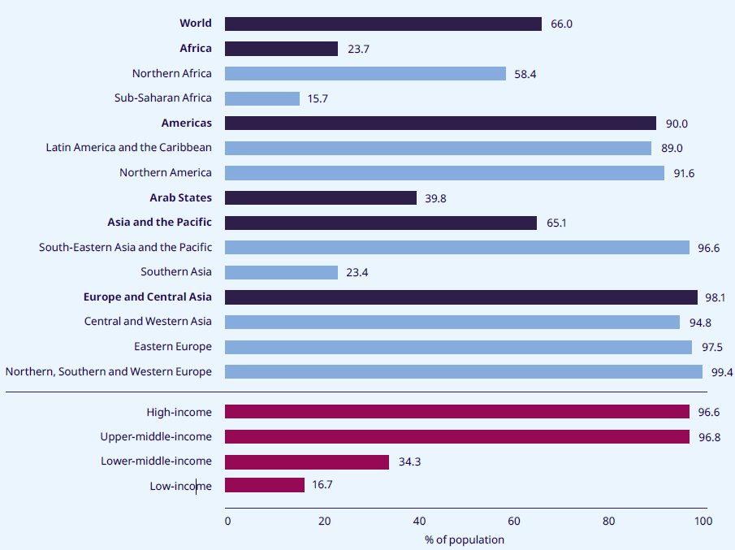
Social health protection
Effective coverage for health protection: % of the population covered by a social health scheme (protected persons), by region, subregion and income level, 2020 or latest available year
Almost two thirds of the global population is protected by a social health protection scheme.
There are pronounced regional coverage gaps, and populations in lower-middle and low income countries are largely left unprotected.
Barriers to accessing quality healthcare remain (i.e. out-of pocket payments, physical distance, availability and acceptability of health services).
This situation impacts health access, women in the poorest quintiles are less likely to have been attended by health staff during labour
The uneven availability and quality of health services is seen in many countries
Health workforce concentrated in urban areas
Under-investments in primary care

Slide 18
Accelerating progress towards universal social protection

Slide 19
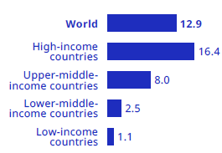
Underinvestment in social protection
Social protection gaps are associated with significant underinvestment, especially in low-income countries.
Securing sustainable and adequate financing is essential, usually through a combination of (progressive) taxation and social insurance contributions.
Need for well-coordinated policies, including employment, macro-economic and fiscal policies, as well as policies to support transitions from the informal to the formal economy.
Public expenditure on social protection (excluding healthcare) as a % of GDP
Notes:
Social protection financing gaps widened due to COVID-19; austerity could have negative impacts on progress achieved
A nationally defined social protection floor will require additional investments. Low-income countries would need to invest an additional USD 77.9 billion or 15.9% of GDP per annum to guarantee at least a basic level of social security for all.
Safeguarding and strengthening sustainable and equitable domestic financing mechanisms for universal social protection systems, including through taxes and social security contributions
International support needed to support countries with insufficient own capacities > exploring options, including for a Global Social Protection Fund

Slide 20
The case for investing in social protection
The financing gap in social protection urgently needs to be closed to ensure at least minimum provision for all - a social protection floor.
Investments in social protection are key to reducing and preventing poverty and vulnerability
International support is necessary to support low-income countries in building up their social protection systems
17 trillion USD mobilised in global fiscal stimulus response

Slide 21
What is needed to take a high road towards universal social protection?
Priority actions
Social protection policies should be reinforced, guided by international social security standards and supported by effective social dialogue.
Coverage and adequacy gaps must be closed; especially for women, workers in the informal economy and migrants.
Adequate protection should be extended to all, including workers in all types of employment, to:
reduce their vulnerability and enable them to seize opportunities;
support their life and work transitions;
help them to better navigate the future of work.
Social protection is essential to support a just transition to a green economy.
Investing in universal social protection is the ethical and rational choice for a better future.

Slide 22
COVID-19 crisis response:
ILO portal on social protection responses to COVID-19, including
Spotlight briefs: Extending social protection to informal workers in the COVID-19 crisis; Unemployment protection in the COVID-19 crisis; Sickness benefits during sick leave and quarantine;
Data dashboard: Social Protection Monitor
Costing tool: Rapid Social Protection Calculator for COVID-19
ILO portal on COVID-19 and the world of work
Universal social protection – covering workers in all types of employment:
World Social Protection Report 2020-22: Social protection at the crossroads – in pursuit of a better future
High-level panel discussion: Social protection at the crossroads – in pursuit of a better future
Policy resource package on extending social security to workers in the informal economy
Extending social security to self-employed workers: lessons from international experience
Social protection systems and the future of work: Ensuring social security for digital platform workers
Extending social security to workers in the platform economy
Extending social protection to the cultural and creative sector
Useful resources
Other key resources:
ILO Social Protection Platform
Joint UN Social Protection and Human Rights web platform
Global Partnership for Universal Social Protection (USP2030)

