Slide 1

Advancing Social Security
in Times of Austerity
ISABEL ORTIZ
Director Global Social Justice, former Director ILO and UNICEF

Slide 2

Social Security: A Human Right and an SDG
Article 22 of the Universal Declaration of Human Rights states “Everyone, as a member of society, has the right to social security”
Social Security (Minimum Standards) Convention, 1952 (No. 102)
The Social Protection Floors Recommendation, 2012 (No. 202), endorsed by the UN and the G20
The Sustainable Development Goals, particularly SDG 1.3
“Implement nationally appropriate social protection systems and measures for all, including floors,
and by 2030 achieve substantial coverage of the poor and the vulnerable”

Slide 3
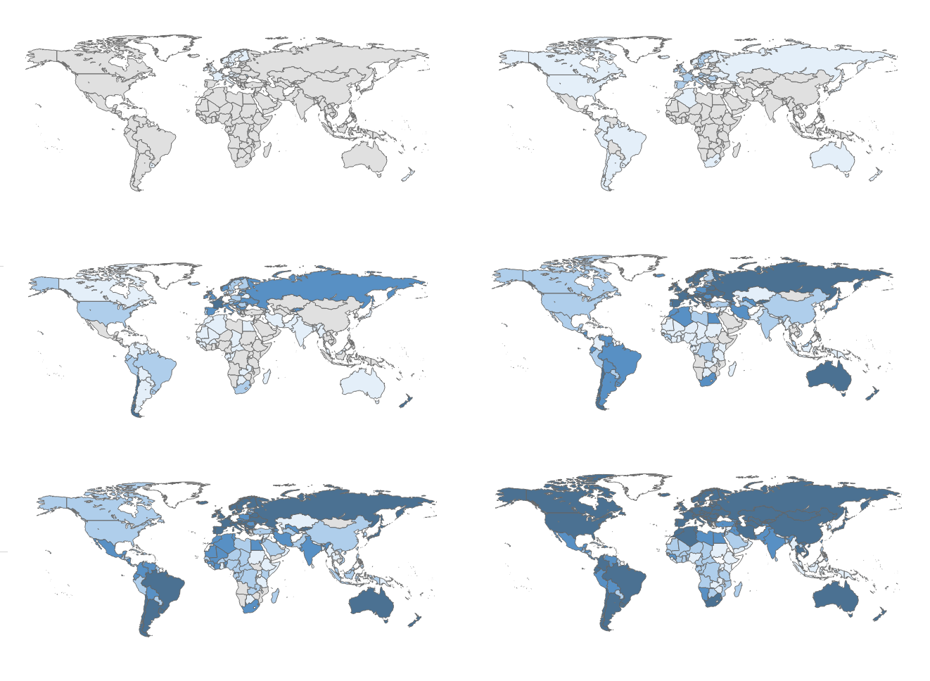
Extension of Social Security/Protection systems over time
Social protection or social security includes PUBLIC SYSTEMS:
child and family,
maternity protection,
Support to those with no jobs/ poor
employment injury benefits,
sickness support,
health protection,
disability benefits,
old-age pensions
Year: 1900
Year: 1920
Year: 1940
Year: 1960
Year: 1980
Year: 2015
Scope of legal coverage
Comprehensive scope (all 8 policy areas)
Nearly comprehensive scope (7 policy areas)
Intermediate scope (5–6 policy areas)
Limited scope (1–4 policy areas)
Source: ILO, World Social Protection Report 2017-19
No data
Notes:
Since the beginning of the 20th century, significant progress has been made: from early steps taken in a number of pioneer countries, the world has seen social protection systems develop at an impressive pace.
At present, most countries have in place social protection schemes anchored in national legislation covering all or most policy areas of social protection, although in some cases these cover only a minority of their populations
Despite progress, large gaps remain in parts of Asia and Africa.

Slide 4
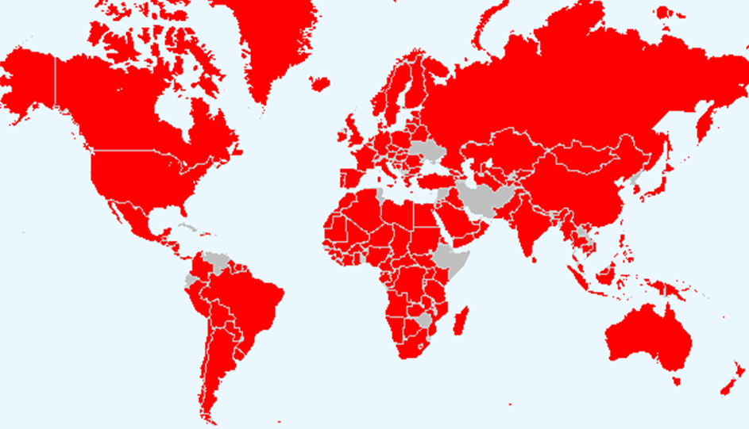
But austerity affecting 6.7 billion people today
Countries projected to contract total government expenditure in GDP terms in 2022-24
Source: Ortiz and Cummins, 2022: End Austerity: A Global Report on Budget Cuts and Harmful Social Reforms in 2022-25, based on IMF’s World Economic Outlook (April 2022)
Note: Data unavailable for Afghanistan, Ecuador, Lebanon, Syria, Tunisia, Ukraine and Venezuela

Slide 5
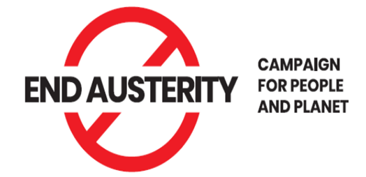
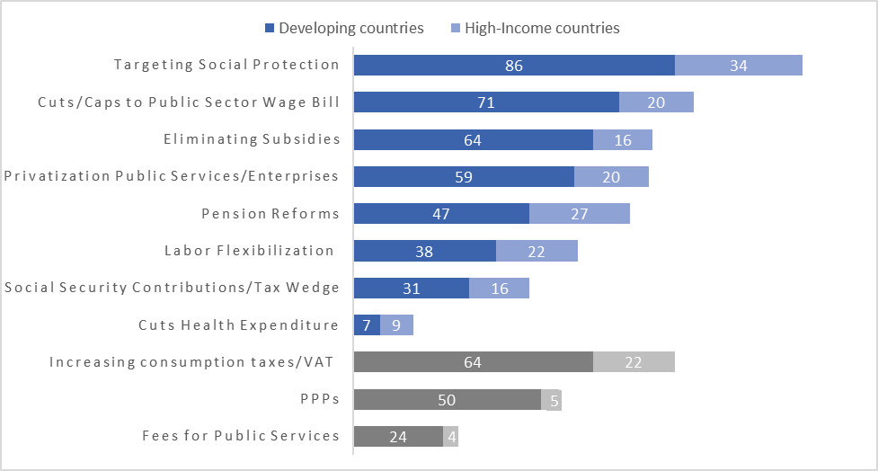
Austerity measures in 185 countries
(in number of countries)
120
91
80
79
74
60
47
16
86
55
28
Source: Ortiz and Cummins, 2022: End Austerity: A Global Report on Budget Cuts and Harmful Social Reforms in 2022-25, based on review of 267 IMF country reports 2020-22.

Slide 6
Austerity or Fiscal Consolidation Measures
Need to watch out for austerity measures. A review of 267 IMF country reports published between 2020-22 shows that the most common are regressive with negative impacts on people, particularly women:
Targeting and rationalizing social protection (“safety nets”) in 120 countries, at a time when governments should be scaling up (not scaling down) social protection.
Wage bill cuts or caps in 91 countries, reducing or freezing the salaries and number of public-sector workers who provide essential services to the population, e.g. teachers, health workers.
Eliminating subsidies (fuel, food, agricult) in 80 countries, despite record-high prices
Privatization/Commercialization of Public Services or SOE Reform, in 79 countries
Pension and Social Security reforms in 74, adjusting/reducing benefits, old-age poverty
Reducing employers’ Social Security contributions/”tax wedge” in 47 countries as a way to support employers but compromising social security sustainability
Labor flexibilization reforms in 60 countries, reducing employment protections
Containing Health expenditures in 18 countries, despite the pandemic.
VAT increases on basic goods and services that are consumed by the poor – and which may further contract economic activity – in 86 countries.
Promoting PPPs in 55 countries
Fees for Public Services in 28 countries

Slide 7
Targeted Social Protection/SNs is Not the Solution
Targeting to a percentage of the poor excludes the majority
- and punishes the working and middle classes & majority of women

Slide 8
Targeting Social Protection also excludes many poor/vulnerable
Exclusion errors for social protection programs targeting the poorest 25% or less
Note that countries have committed to Universal Social Protection Systems:
Human Rights
International Labor Standards
Conventions & Recommendats’
SDGs

Slide 9
Typical Universal Social Security/Protection System
Countries achieve universality by a mix of PUBLIC social insurance (financed from contributions) and a floor of social assistance (financed from the general budget)
Benefits level
BUT:
IFIs reducing
employers’ Social Security contributions (”tax wedge”) to support enterprises
IFIs reforming pensions lowering benefits
IFIs targeting and rationalizing social assistance (‘safety nets”) for cost-savings
Private savings (Voluntary)
Public Social Insurance (mandatory)
financed by employers and workers contributions
Social Protection Floor (Social Assistance)
Low income
Coverage of the population
High income

Slide 10

Social Security/Protection System after IFIs Austerity Reforms
A smaller, targeted social protection floor (lower cost to the budget)
Smaller PUBLIC social insurance with lower benefits (lower employer contributions, making system unsustainable)
Larger private savings (to the financial sector)
Inequality to increase
Benefits level
These are
Pro-rich policies.
Who benefits?
  Winners:
  The financial sector, employers
  Losers:
  Citizens, workers
Private savings (Voluntary)
Financial Sector
Public Social Insurance (mandatory)
financed by employers and workers contributions
Safety Nets
Low income
Coverage of the population
High income

Slide 11
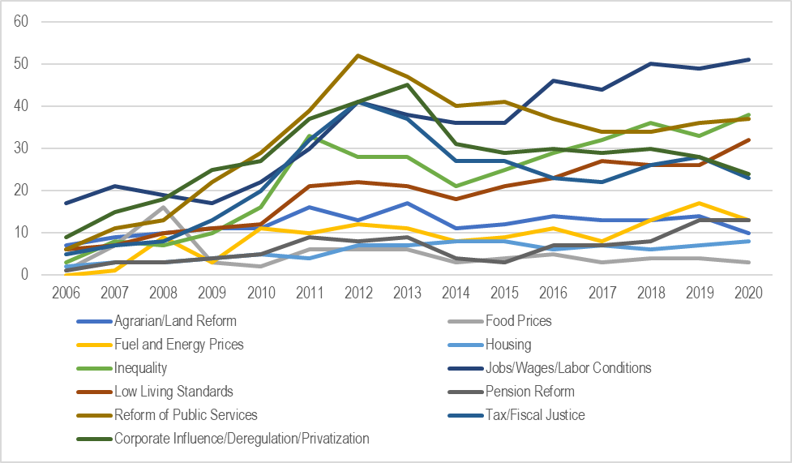
Austerity reforms with negative social impacts
increase social conflict
Austerity policies have increased poverty and inequality -in particular for women-, undermined progress on human rights, and sparked social conflict.
  Rising discontent and conflict: Anti-austerity protests in 101 countries, 2006-2020 (in number of protests/year)
Source: Ortiz et al., 2022: World Protests. Palgrave Macmillan.

Slide 12
There are Alternatives to Austerity
Financing/fiscal space options exist even in the poorest countries
There are at least 9 options, known to governments and fully supported by policy statements of the UN and the IFIs:
Increasing progressive tax revenues (avoiding regressive taxes like VAT) for example, taxes on corporate profits, financial activities, wealth, property, imports/exports, natural resources, digital services or ending ‘special economic zones’ and other tax exemptions/breaks to big corporations. For example:
    Wealth taxes: Argentina, Iceland and Spain
    Taxing windfall profits in the energy sector Algeria, Angola, Australia, Canada, Kazakhstan, Italy, Mauritania, Mozambique, Norway, Papua New Guinea, Russia, Saudi Arabia, the UK
    Taxing Digital services: Belgium, Canada, France, India, Indonesia, Kenya, New Zealand, Tunisia, Türkiye
    Financial transactions tax in Argentina, Brazil; and new taxes to banks’ windfall profits Hungary and Spain
    Mining and gas taxes: Bolivia, Mongolia and Zambia financing universal social protection schemes such as pensions and child benefits
Fighting illicit financial flows: These are large, such as money laundering, bribery, tax evasion, trade mispricing, and other financial crimes

Slide 13
There are Alternatives to Austerity
Financing/fiscal space options exist even in the poorest countries
  Restructuring/eliminating debt – concept of illegitimate debt. Five main options: (i) debt relief/cancellation (eg HIPC); (ii) re-negotiating debt (more than 60 countries in recent years); (iii) debt swaps/conversions (over 50 countries); (iv) repudiating debt; and (v) defaulting (more than 20 have defaulted or repudiated public debt, such as Ecuador, Iceland and Iraq, investing savings in social programs). An international debt resolution mechanism and more debt cancelation needed.
  Increasing social security contributions by adequate employers’ contributions and formalizing workers in the informal economy with decent contracts (eg Argentina, Brazil, Tunisia, Uruguay).
  Re-allocating public expenditures focus on replacing high-cost and low- social-impact expenditures (eg. defense - Costa Rica, Thailand)
  Tapping into fiscal and foreign exchange reserves (eg Chile, Norway).
  Adopting a more accommodative macroeconomic framework (tolerance to some inflation, fiscal deficit).
  Lobbying for more aid and transfers (e.g. Global Social Protection Fund).
  New SDR allocations, but with a better mechanism that does not increase debt and conditionalities, a fairer and periodic distribution of SDRs

Slide 14
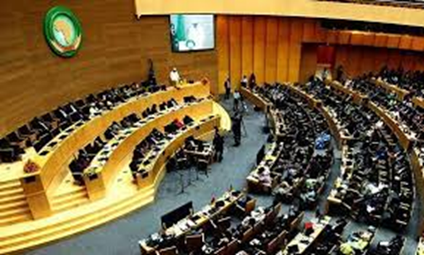
Ending Austerity and Advancing Social Security: What Can Citizens Do
Expenditure and financing decisions that affect the lives of millions of people cannot be taken behind closed doors at the Ministry of Finance –Bad governance!
Identify if your government is cutting public expenditures (check EndAusterity website, IMF website)
Make yourself heard (e.g. demand more social security programs with better benefits, quality public services, etc)
CALL FOR NATIONAL SOCIAL DIALOGUE
Carry out a rapid and timely assessment of the social impacts of the different policy options and financing alternatives
Agree optimal policies through national social dialogue with representative trade unions, federated employers, CSOs and other relevant stakeholders.
JOIN the #EndAusterity Campaign
https://www.endausterity.org/
JOIN the Campaign Social Security for All:
https://www.socialprotectionfloorscoalition.org/
social-security-for-all/

Slide 15


THANK YOU
REFERENCES:
Ortiz and Cummins (2022): End Austerity: A Global Report on Budget Cuts and Harmful Social Reforms in 2022-25.
Ortiz, Chowdhury, Duran, Muzaffar and Urban (2019) Handbook on Fiscal Space for Social Protection: Assessing Financing Options Geneva and New York: ILO and UNWOMEN

