Slide 1
What Makes The Just Transition Just
Noma Jakuja

Slide 2
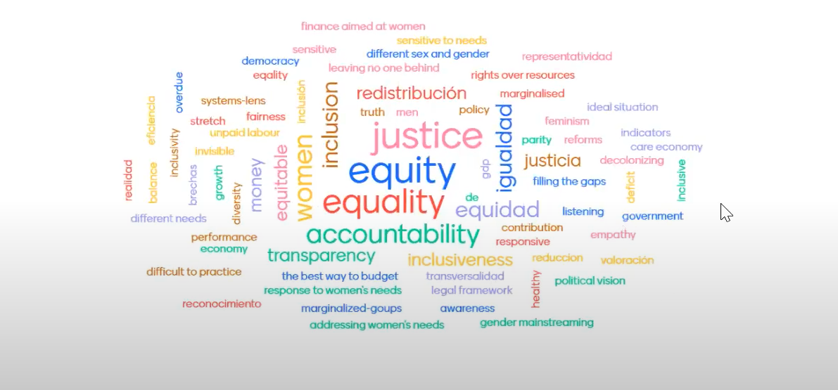

Slide 3
Local Context
There are both explicit and implicit agreement that the minimum standard of what marks a transition just in South Africa ought to be one that leaves no South African behind, but a clearly defined standard and agreement of what this means is not clearly articulated.
If South Africa is to leave no person behind in transitioning towards net zero emissions by 2050 and ensure the process is truly just there are hard truths that the country needs to firstly admit and accept.
The first is that South Africa is currently the most unequal society in the world with a GINI income coefficient of 0.63.
Secondly the country has staggering unemployment numbers especially among the able bodied, and of working age.
South Africa’s Just Transition Policies need to account for this reality and see the transition as an opportunity to address these social and economic ills.

Slide 4
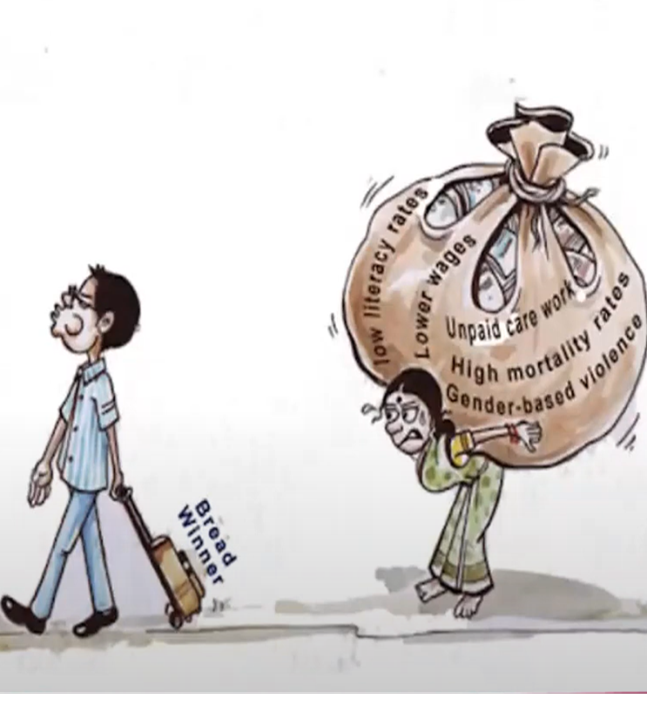
Gender Disparity Throughout all Ages

Slide 5
Role of Social Security in the Just Transition
In its truest sense the concept of ‘Just Transition’ originated in the United States of America in the 1980s when organized labour and environmental groups began to advocate for public policies protecting the natural environment as well as workers.
It emphasized that workers’ rights should be protected in any transition to a green future.
The concept has since been used to refer to and acknowledge multiple framings that are context specific but underpinned by the same principles driving different policy positions and practices.
The IPCC 2022 report highlighted for the first time in the global climate change discourse the importance of the social and demand side aspects of climate mitigation strategies. Until then climate mitigation solely focused on the supply side looking at green infrastructure and putting in place and developing the appropriate technologies needed to reduce emissions.

Slide 6
Role of Social Security in the Just Transition
However, policies that focus on the demand side of the economy and improving the wellbeing of people have a potential for large reductions in global greenhouse gas emissions while at the same time improving socio-economic ills such as inequality and poverty alleviation.
Climate change policies that deliberately address equity in the Just Transitions can support deeper ambitions for accelerated climate action and galvanize wider community acceptance of transition decisions taken.
The most effective and appropriate policies in the Just Transition are ones that account for international, national, and regional circumstances including accounting for current country conditions and enablers available in a country.
Social security has an important role to play in the Just Transition process of a country especially a country like South Africa with high unemployment rates and high-income inequalities as well as high poverty levels.
It can play a direct climate mitigation strategic role as well as an indirect role by acting as an economic stimulus in a country to generate demand side economic activity by placing money directly into the hands of individuals and households who will in turn spend the money in the economy.

Slide 7
Role of Social Security in the Just Transition
Social security is also important because it recognises vulnerable members of society and encourages economic participation of this group.
It can challenge existing power relations in the system and can play a vital role in the inclusion of the 72% currently excluded black women in the economy.
Social security can empower these vulnerable groups in society to influence and collectively or individually own the decision-making process in the Just Transition while also allowing the power to challenge existing power relations in the workplace and home by granting them the option to opt out of certain decisions.
Social security can also play a distributional role. It can cushion against direct impacts of the transition, most commonly related to job losses in specific sectors, loss and damage of property and lives due to extreme weather conditions.
An expansive social security using a universal approach also includes a wider definition of vulnerable groups as beneficiaries such as those in employment for example in the financial sector or legal sector who currently have jobs but are at risk of losing their jobs with the introduction of new technologies and artificial intelligence.

Slide 8
Role of Social Security in the Just Transition
While South Africa has several social security measures in place covering the elderly, disabled, the unemployed provided they meet the Unemployment Insurance Fund (UIF) criteria the social security landscape remains highly fragmented and exclusionary.
Social security has a fundamental role to play because of its social inclusion dimension.
The social inclusion dimension of social security recognizes marginalized groups and can make them active participants in the economy by placing money into individual’s hand or at the household level.
With 42.4% of South Africans currently not participating in the economy due to unemployment South Africa needs a social security stimulus in the Just Transition.
One that is big enough to accommodate these already existing challenges while anticipating additional ones such as losses to lives and property due to extreme weather conditions.
A social security measure in South Africa is not just a moral obligation but and economic need.

Slide 9
Role of Social Security in the Just Transition
South Africa needs a social security mitigation strategy that is highly expansive, inclusionary, and distributional not only to accommodate and facilitate a Just Transition but large enough to accommodate the historical legacies contained in the social security sector.
SPI advocates for a Universal Basic Income to be included as a mitigation and adaptation strategy in the country’s Just Transition pathway.

Slide 10
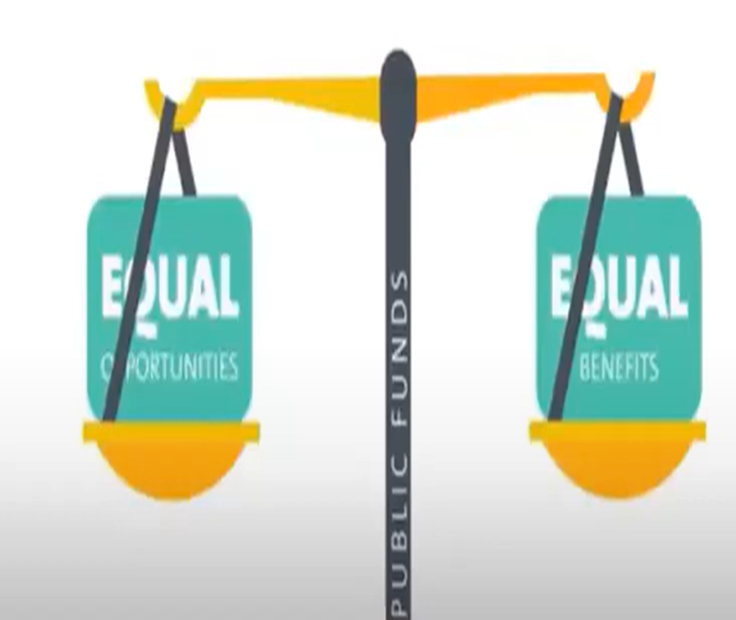
Universal Basic Income
UBI guided by principles of inclusion, redistribution and equality can fundamentally realign the purpose of the economy towards meeting not only Gross Domestic Product (GDP) growth rates but bring about the necessary conditions to thrive in life based on feminist references.
SPI calls for a UBI to be implemented in South Africa as a measure to define the minimum standard of living for all South Africans.
The UBI stimulus needed for South Africa is estimated at a total cost of R547.8 billion over three years.

