Slide 1
The necessity of social security for economic
transformation and economic development in SA
Seeraj Mohamed
Views presented here are my views and should not be attributed to my employer

Slide 2
Introduction
My arguments in favour of social security are not because social security is necessary for economic transformation and development in South Africa (SA)
Governments must be held accountable for ensuring provision of adequate social security
My presentation shows why social security is necessary for economic transformation
I explain key characteristics of the South African economy and the reasons for poor growth, increasing unemployment, high unemployment and growing equality

Slide 3
Structural change and wellbeing
The approach to structural transformation discussed here is that, ultimately, structural transformation requires disruption and a shift in the power relations within the economy and in the relationship between the state and vested interests, particularly corporate vested interests
The interrelationship between improved wellbeing and social welfare with structural transformation was present in the early literature on development economics and patterns of change in economies, including Arthur Lewis, Simon Kuznets and Hollis Chenery & Moshe Syrquin

Slide 4
Development economics
The experience of Japan and the Asian Tigers (and China) has been that social security is taken care of by growing employment and real wage increases – more equal growth
Before the Washington Consensus (WC), pioneered by the World Bank from the early 1980s, there was a two-fold conventional wisdom that
development depends upon industrialisation and
industrialisation depends upon significant state intervention
The notion of development, the developmental state, and industrial policy has been undermined and eroded by neoliberal thinking
While the WC tended to accept the central role of industrialisation, contingent upon its being driven by market forces, it was heavily against the role of the state in industrialisation.

Slide 5
The WC excluded social policy from structural economic transformation
Even though, the Washington Consensus may have shifted to its post Washington version, the idea of development itself became and has remained degraded in the following ways:
Economic transformation or structural change tends to be seen as merely shifting the sectoral composition of the economy;
Social policy is attached to providing safety nets, either explicitly in case of what were taken to be temporarily adverse circumstances, or in making up for deficiencies in provision of health, education, housing and so on
Deregulated financial markets are not seen as inevitably destabilizing in and of themselves or through resistance to, and/or avoidance of, (re)regulation and so not causal of the misallocation of finance

Slide 6
The anti-social role of finance is ignored
Financial markets are presented as more or less efficient, even imperative policy-manipulable vehicles for financing development and for sustaining developed economies (with massive levels of support following the Global Financial Crisis being indicative).
Financial institutions have become misrepresented as merely (in)efficient intermediators and allocators of capital and, thereby, largely absent and blameless in erstwhile mainstream, neoliberal explanations of the problems that plague economies, such as deindustrialization, high unemployment, growing inequalities and the path to irreversible environmental damage and calamities.
When in fact they should be understood to be driving contemporary capitalism

Slide 7
The South African economy
The structure of the economy should be considered as more than just the contribution of different economic sectors
Household reproduction and the impact of unemployment, poverty and inequality (UPI) is key to understanding the structure of SA’s economy
The fundamental problems of the economy are caused by those who control the large corporations (including financial institutions) that dominate most of the market in SA and most of the wealth
The government through adoption of neoliberal economic policies, including its retrogressive macroeconomic and financial policies, has allowed large corporations to maintain an economy that is extractive, environmentally damaging and incapable – and very likely uninterested – in increasing employment and ensuring adequate social security

Slide 8
The evolution of the SA economic structure
Fine and Rustomjee (1996) assert that the system of accumulation that took shape in South Africa can be described as a minerals-energy complex (MEC).
The central role of the mining industry and the coordination and control of mining-finance houses played an important role in developing the extractive sectors of the economy during the second half of the nineteenth century and well into the twentieth century.
They worked closely with the colonial and later the apartheid governments to manage a cheap black labour system built on1913 Land Act that set aside 87% of the land SA for whites
The SA industrial base and services sector developed to support the mining industry with a small manufacturing, utility sector and other services focused on the white population.

Slide 9
The structure of the economy in 1994
The industrial base of the South African economy at the time of the 1994 democratic elections was dominated by sectors with close economic linkages to the mining industry.
These were predominantly processing, capital and energy intensive industrial sectors.
The overall level of manufacturing value added was low with much of South Africa’s minerals exported in raw or slightly beneficiated form
The largest dominant corporations responded to the political changes in a defensive manner.
Large corporations shifted their primary listings abroad or dual-listed.
They continue to move large amounts of capital abroad legally and illicitly

Slide 10
Neoliberal policy hegemony and 3 lost decades
They also worked to convince Mandela and the economic leadership of the African National Congress that the new, democratically elected government should adopt free-market, neoliberal economic policies
The ANC agreed to central bank independence and clauses about fiscal responsibility in the negotiations for the Constitution
They adopted the neoliberal Growth Employment and Redistribution Programme and further entrenched an austerity, mainstream fiscal policy approach within the Public Finance Management Act
As a result, the Socio-Economic Rights within the Constitution have not been achieved and the courts have interpreted these rights to be incrementally achieved if affordable

Slide 11
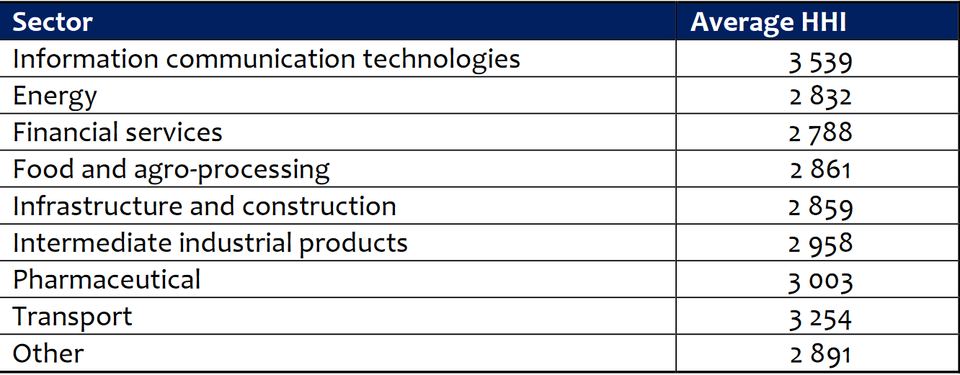
Concentration in the SA Economy
Average market share estimates of dominant firms identified across priority sectors
Source: Buthelezi, Mtani and Mncube, 2018

Slide 14
Capital stock of different sectors, 1994 & 2020

Slide 16
Employment for different sectors

Slide 19
Conclusion
Structural reforms being implemented by the government where successful will largely maintain and benefit status quo
Large corporations will use their market power and access to rents to extract wealth from SA while arguing that is not a good place to invest
Large corporations and the government intent on neoliberal policies will increase UPI and socio-economic and political instability
The impact on household reproduction is worsening
Impact of climate change and other crises (the ‘polycrisis’) will worsen
An important part of the solution will require reducing the power of private finance, regulation and capital controls and reversing financialisation
State allocation of finance and development finance institutions will have to play a much larger role and a larger role

Slide 20
Conclusion
A new green growth path is needed:
Improved and increased provision of services and adequate social grants that increase household resilience and aggregate demand
Industrial and agricultural policy has to support businesses and sectors that will have to grow to increase supply of publicly provided basic services and associated infrastructure as well as the increase of products purchased by the majority of households
The improved and additional houses, schools, clinics and other infrastructure and the energy, manufactured products and services will have to be produced in in accordance with high environmental standards and just transition goals

