Slide 1
Framing of a UBI in South Africa and How it should be financed
Noma Jakuja

Slide 2
A Longitudinal Analysis of South Africa’s GDP Growth Rate

Slide 3
Universal Basic Income
A Universal Basic Income (UBI), while not a new concept, has gained prominence as a policy tool to respond to the rise in inequality, income insecurity and the rise in precarious work associated with the changing nature of work and globalization.
The rise in precarious work coupled with the introduction of new technologies in certain sectors both as a response to innovation and climate mitigation will result in the changing face of those who require social security in South Africa.
There are many proposals to structuring a UBI, these range from minimal budget-neutral stipends to larger UBI proposals for the advancement of social and economic justice.
The impact of a UBI on the economy and its ability to reduce poverty and inequality is influenced by the size of the UBI, the level of benefits contained in the policy design and its ability to meet people’s needs.
The financing mechanisms of a UBI also play a determinant role to the policy’s effectiveness.
Studies on UBI have found that an effective UBI policy needs to provide for a basic minimum standard of living for everyone in the country, not only those currently without a job but those who are vulnerable to job losses and income security as well as children

Slide 4
Universal Basic Income
A UBI policy needs to be redistributive in design, an unconditional cash transfer to all citizens in the country to bring about the desired outcomes of poverty alleviation and economic activation.
The implicit assumption is that those currently in jobs will opt out of accessing their benefits contained in UBI but should need ever arise the benefit is expanded to them as well.
To date South Africa has not implemented any policy, weather an economic or social one, that has challenged the predesigned economic power dynamics of the system in the country by addressing the root causes of the system.
A UBI in South Africa would not necessarily uproot the roots of the current economic system but would absolutely change the purpose of the system by changing the purpose of social security assistance and its contributory role to demand creation in the country.
A UBI in South Africa can also create a new economic architecture with a strong female-orientation by firstly bringing into the economy the 72% currently excluded women and increasing the bargaining power of women by placing incomes directly into their hands.

Slide 5
UBI As A Macroeconomic Stimulus
Regressive sources of financing a UBI such as taxes on households curtail the redistributive impact of a UBI.
Financing options for a UBI should therefore be progressive and sustainable in time.
The ability of a UBI to be redistributive drives its ability to reduce inequality and thus should be preserved in the financing options chosen by a country.
Using the Reserve Bank’s foreign exchange reserves: Using foreign exchange reserves to finance a UBI in South Africa will entail drawing down on state funds special funds such as its excess foreign exchange reserves. Chile and Norway are examples of countries that have made use of their fiscal reserves for social investments and developmental goals. Over the last decade, the accumulation of foreign exchange reserves by central banks has increased six-fold. In the wake of rising domestic economic and social challenges this accumulation of foreign exchange reserved has come under scrutiny and challenged in several countries

Slide 6
UBI As A Macroeconomic Stimulus
At the end of June 2022, South Africa had foreign exchange reserves amounting to R963 billion – well above the required R345 billion in line with international standards to meet three months cover.
2. Global Climate Change Funds towards a sovereign wealth fund: To date South Africa has received a total of 415.0 million from the Green Climate Fund which has funded 9 projects and none has gone towards social security policies and programs.
The Adaptation Fund to date has made a budget of 10 million USD available to South Africa and begun funding two project in the country.
The Global Environment Facility has released over 40 million USD to fund projects in South Africa to date.
It is therefore important for South Africa’s NDC to explicitly stipulate that at least 35% of global climate financing received should go towards financing the UBI in the country.
These funds should go into a social bond with the National Treasury as the main custodian and bond issuer.

Slide 7
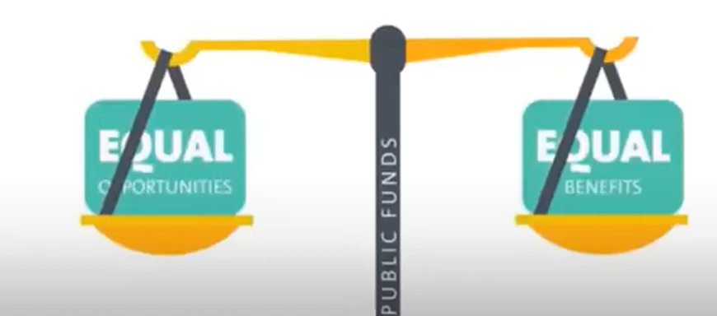
UBI As A Macroeconomic Stimulus
South Africa has a well-developed financial sector that can be leveraged in structuring and issuing of social impact bonds.
If these green funds are not channeled towards addressing the country’s biggest social ills, this will result in a lost decade of funding to finance social security and other developmental measures in the country.

Slide 8
Conclusion
South Africa is at a defining moment in history where it can relook its macroeconomic polies to date and change them to ensure that they speak to the current realities and context of the country particularly black women who are largely marginalised by the current macroeconomic policies.
With the Just Transition opening the window of opportunity to redefine and redesign the country’s macroeconomic policies to truly ensure no South African is indeed left behind in the pathway to reach net zero emissions by 2050.
While not a silver bullet, the implementation of a UBI can address a wide range of challenges in the country while playing a critical redistributive role.

