Slide 1
Framing, Financing, Delivering a Green Basic Income for a Just Transition
Reinhard Huss
UBI Lab Leeds and Network, BIEN, UBIE

Slide 2
Objective
Propose green and just Basic Income financing institutions

Slide 3
Outline
Meaning of Basic Income (BI)
Framing
Financing
Delivery
Conclusions

Slide 4
What is a Basic Income?
A Social Security Floor for All
Universal (with some challenges as long as it is not global)
Unconditional
Cash
Individual
Periodic and Permanent
(BIEN definition)

Slide 5
Framing

Slide 6
Who owns this place?
Earth is our collective inheritance and responsibility and should be treated accordingly and lead to moral and legal liability.

Slide 7
What is wrong with conventional Economics?
Diagram highlights many problems!
Relevance for Basic Income:
Household is simplified!
Commons does not exist!
False antagonism between
state and market or
bureaucracy and neoliberalism

Slide 8
What is the misleading Framing?
Costs
Cost Perspective?
Societal costs are Zero! Redistribution!
Affordability
Definition?
Percentage of Gross Domestic Product
Feasibility
Meaning?
Political Will or Public Demand
Example: Family Basic Income

Slide 9
Free Money versus Free-Riding
Free Money
Right to Subsistence
in a Full World
Simple Life
free of Waste, Pollution, Resource depletion or
Burden on our Future
Compensation
for Free-Riding
of our Commons

Slide 10
Financing

Slide 11
Public Services and Basic Income
Services and Goods:
Health, Education, Transport, Housing, Information & Communication
Financing:
Earned and Unearned Income Tax
Wealth Tax
Principle:
High Earners and Wealth Owners make high contribution to collective purchase
Goods and Services:
Food, Hygiene, Clothing, Culture, Arts, Sports
Financing:
Value-Added Tax (VAT) and Carbon Tax
Explanation: Regressive Tax becomes progressive through UBI
Improved Options: Progressive VAT,
BI cash card for VAT-free purchase
Principle:
High Consumers make high contribution to redistribution to secure essential consumption of all people/residents

Slide 12
Commons Compensation Scheme
Historical
Slavery
Colonialism
Extractivism
Non-Renewable Resources
Biotic e.g. Species
Abiotic e.g. Minerals
Land
Space
Human-made
Legal Framework
Intellectual Property
Physical Property
Financial Property
World-Wide-Web (Digital)
Renewable Resources and Sinks
Animals and Plants
Water
Soil
Air

Slide 13
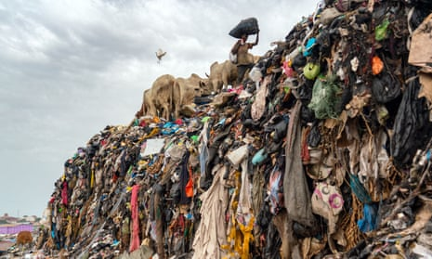
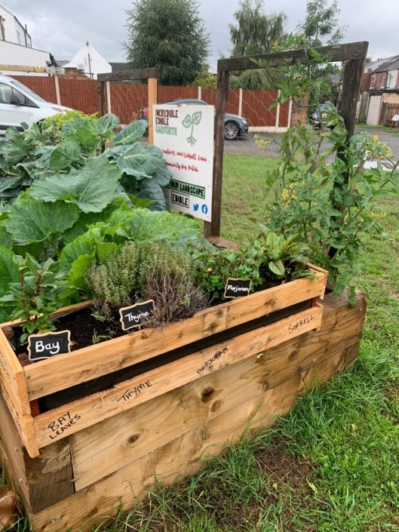
Transition to Green Economy
Past and Present
Future
Linear Degenerative = Trash planet
Free-riding of our Commons
Circular Regenerative
Contribute assets and fees to
Commons Wealth Funds
Source: Guardian.org Muntaka Chasant/Rex

Slide 14
Fees, Dividends and Assets rather than Taxation
Principle:
Use, burden, harm and extraction of Commons will lead to behavioural fees, dividend and asset sharing
Examples:
Land Value Fee
Financial Transaction Fee
Carbon Fee
Single Use Item (Plastic) Fee
Pollution (Synthetic Fertilizer Fee)
Inheritance Assets
Mineral Extraction Assets

Slide 15
Just Transition
Compensate Societies for Harm caused by slavery, colonialism, past extractivism and pollution (e.g. CO2)
Share with Societies Dividends and Asset creation because of past, present and future private exploitation of land, capital and use of legal Commons and public infrastructure

Slide 16
Behavioural Fees
Behavioural fees (similar to Environmental, Pigovian, Excise taxes) on so-called ‘free use’ of our Commons by firms (legal entities) and individuals
Local and national adaptation for a just approach
Current examples: parking, congestion and emission fees

Slide 17
Delivering

Slide 18
Commons Wealth Funds versus State
Commons Wealth Funds
State
Autonomous BI institutions
Requires initial state legislation
Democratic governance structure
Transparency and Accountability
Several Funds (Trusts) provide additional resilience and protection against corruption
Reliance on lasting political will
Risk of competing political options, e.g. Health versus Basic Income
Hypothecation of taxes for BI required
Risks of political manipulation
Risks of corruption

Slide 19
Combine Public Services and Basic Income
Example: Transport
Advantage
Flexibility
Choice

Slide 20
Well-being and Security

Slide 21
Conclusions
Basic Income will
Assure Social Security for All
Be framed as a dividend and compensation for the use of our Commons
Be an ingredient for a just and rapid transition to a Grandchildren-friendly Society with an embedded Green Economy.
Contribute to an emancipatory Social Structure and Institutions
Transform the actual Master – Servants to a Citizens – Citizens social relationships

Slide 22
Theory of Collective Actions Elinor Ostrom (1933-2012)
Common Pool Resource Institutions
Self-organisation and self-governance
Appropriation and provision of resources
Focus on local organisations but also multiple layers of nested organisations for larger common pool resources
Source: Ostrom, Elinor (1990). Governing the Commons: The Evolution of Institutions for Collective Action. Cambridge: Cambridge University Press

Slide 23
Contact Details
Reinhard Huss
Email: r.huss@posteo.net
Websites:
https://ubilableeds.co.uk/
https://www.ubilabnetwork.org/
https://basicincome.org/

Slide 24
Selected Bibliography
Basic Income Earth Network (BIEN). 2023. About Basic Income. Website: https://basicincome.org/about-basic-income/
Kim DD et al., Perspective and Costing in Cost‑Effectiveness Analysis 1974–2018, PharmacoEconomics (2020) 38:1135–1145, https://doi.org/10.1007/s40273-020-00942-2
Ostrom, Elinor (1990). Governing the Commons: The Evolution of Institutions for Collective Action. Cambridge: Cambridge University Press
Raworth, Kate. 2017. Doughnut Economics – Seven Ways to Think Like a 21st Century Economist. London. Random House.
Standing G. 2019. Plunder of the Commons. A manifesto for Sharing Public Wealth. UK: Penguin Pelican Book.
Standing G. 2022. The Blue Commons. Rescuing the Economy of the Sea. UK: Penguin Pelican Book.
Van Parijs P and Vanderborght Y. 2017. Basic Income – A Radical Proposal for a Free Society and a Sane Economy. Cambridge, Massachusetts: Harvard University Press.

