Slide 1
Social Security Policy responses to realities of the informal economy
NICOLA YON

Slide 2
The Informal Sector
Workers in informal employment make up 61% of the global labour force - more than two billion workers. Nearly 83% of employment in Africa and 85% in Sub-Saharan Africa is informal (ILO,2022). In South Africa, the ILO estimates imply that informal employment represents over 40% of total employment while output of the informal sector is estimated to be almost 30% (ILO, Informality database)
In the past, policy narratives in Africa tended to either neglect informal economies or even view them as potentially threatening to formal economies – therefore needing elimination and control rather than support and investment for inclusive structural economic transformation.

Slide 3
The Informal Sector ctd
Over time an alternative policy narrative began to take root as it dawned on policy makers that the informal economy was here to stay and played a significant role in contributing to African country’s economies. While this narrative still viewed the informal economy as outside formal arrangements, and often found on the edge of high vulnerability to poverty, low earnings, irregular incomes, bad working conditions, and dominated by women it brought significant attention to welfarist policies to ensure safety nets, minimum floors, and access to basic social protection.

Slide 4
Why does the informal sector matter?
Social justice- everyone should benefit from a country’s resources including social protection initiatives.
Human Right-Everyone should have the right to social protection. (Universal Declaration of Human Rights -1948)
Decent work-because they operate outside the formal system they are exposed to dangerous and precarious working conditions.
They contribute to a country’s development through various taxes and therefore deserve to be recognised and benefit from social security initiatives.

Slide 5
What is impeding the extension of coverage to the informal economy?
Reducing Legal barriers- some countries legislation explicitly excludes certain groups of workers from social insurance coverage based on employment status, occupation or sector. Commonly excluded workers encompass domestic workers, migrant workers, own account workers and agricultural, casual and temporary workers. Where the self-employed and typically hard to cover groups are shielded with protection thanks to national legislation, it is mostly on a voluntary basis and these schemes are largely ineffective in achieving broad coverage due to adverse selection.

Slide 6
What is impeding the extension of coverage to the informal economy? ctd
Weak or ineffective enforcement of applicable labour and social security regulations obstruct the expansion of social protection coverage.
Limited institutional capacities and supply side constraints-making it difficult to carry out well intended policies. Insufficient matching of demand and supply –hence in creating social security policies and undertaking social security initiatives the informal economy should be brought it- have they buy in –include them as much as possible.
Lack of incentives for formalization and social security registration may discourage workers and employers from operating in the formal economy and joining social security.
Notes:
If members do not perceive the “ value for money” due to for example poor quality of service, inadequate benefits or the mismatch between benefits and priority needs their willingness to join a scheme might be limited even if they could afford to pay contributions.

Slide 7
What is impeding the extension of coverage to the informal economy? ctd
Limited information and awareness on social protection rights, available schemes and programmes etc.
Lack of organization and representation- the informal economy is characterised by the absence of worker’s representation and organization making it difficult for workers to voice and defend their rights-especially persons at the bottom of the informal sector pyramid e.g. subsistence farmers, domestic workers etc.
Burdensome and lengthy administrative procedures and processes-registration, contribution payment, delivery and claiming mechanisms are often designed without considering the characteristics of informal workers. Tend to be lengthy processes that impose a high burden on workers especially those with limited administrative capacity.
Notes:
- Contribution payment schedules or methods may not be in line with the characteristics and income patterns of informal sector workers.

Slide 8
What is impeding the extension of coverage to the informal economy? ctd
Affordability- many workers and employers in the informal economy have little income or volatile income, live in poverty or are at risk of poverty which limits their capacity to contribute (regularly).
Weak governance structures-both at policy design and operational levels which negatively affects efficiency, effectiveness and equity of service delivery and limits trust of participants in the system.
Knowledge gaps about workers in informal employment-large gaps in information regarding workers in the informal economy e.g. size, characteristic of employer etc make it challenging to extend social protection to them.

Slide 9
So, what can be done for them?
Approaches to ensure social protection in the informal economy include- Contributory initiatives e.g. social insurance such as health, pensions, unemployment etc. Non-contributory initiatives- social assistance, such as conditional and unconditional cash transfers, social pensions, stipends and in-kind transfers.
Formalize the informal sector-there should be commitments to close coverage and adequacy gaps in social protection to facilitate their transition from the informal to formal economy and create decent work e.g. Malaysia, Brazil, Argentina- promote formalization through an alliance between the tax authority and social security institution-they established a simple and unified collection scheme for small contributors (ILO,2014).
Promote an inclusive and effective legal and institutional framework that provides adequate protection for all workers, that speaks to their needs- a majority of countries have laws that to do not cater for those in the informal economy leaving them exposed to harassment and other vulnerabilities. E.g. Bolivia, China, Philippines- extended the scope of law to include domestic workers and to ensure they protection (ILO, 2013)

Slide 10
So, what can be done for them? ctd
Expand or adapt existing schemes to include them- this strategy although usually targeted at but not limited to categories of workers who are closer to the formal economy and have some contributory capacity. Initiatives can include- reducing legal barriers-extending legal coverage to specific occupations such as domestic workers (Philippines and Uruguay); modifying eligibility conditions on the minimum period of employment (as in Netherlands and Viet Nam), extending mandatory social insurance to the self –employed (Indonesia, Japan, Korea, Philippines).
Follow a gradual extension strategy- one sector/ group at a time-step by step.

Slide 11
So, what can be done for them? ctd
Establish separate (new) schemes-these include specific contributory schemes that target specific groups e.g Algeria and Belgium. Sector and occupation specific schemes e.g. China and India created schemes specifically for construction workers that address they unique needs and barriers.
Enhance organization and representation of the informal economy e.g. Cambodia the Independent Democracy of Informal Economy Association a union representing informal workers (street vendors, taxi drivers, tuk-tuk drivers etc) advocates for workers rights to social protection benefits and assists workers in accessing the National Social Security Fund’s ID card for free health (Oxfam, 2018).

Slide 12
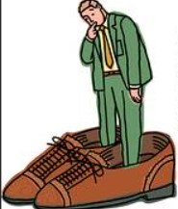
So, what can be done for them? ctd
Introduce comprehensive and integrated extension strategies in line with national priorities.
Tailor schemes, programmes and policy measures to the needs of the informal workers.
Introduce Financial Incentives- government can provide subsidies for social insurance contributions or financing the benefits of low income or other vulnerable workers e.g. Brazil, Thailand and Uruguay.
Most importantly bear in mind that there is no one size fits all. Bench marking is good, but a country’s national context should be considered.

Slide 13
So, what can be done for them? ctd
Simplify administrative procedures and step up access to administrative services
Foster complementary interventions beyond social protection – labour legislation and regulation, formalization of enterprises, tax policies and promoting organization and representation
Intensify awareness raising and share information
Promote trust in social protection systems
Combine the extension of contributory coverage with the establishment of national social protection floor

Slide 14
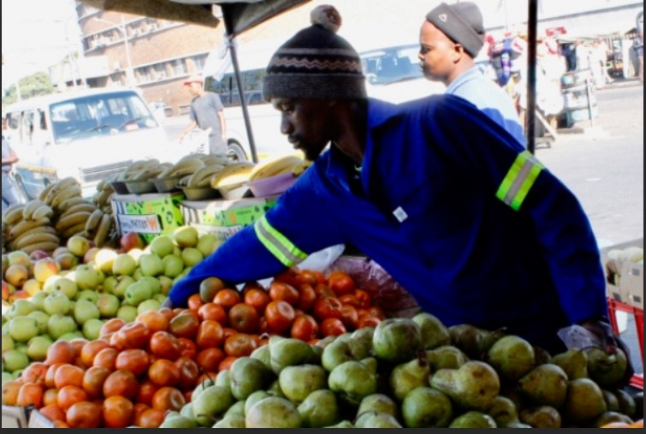
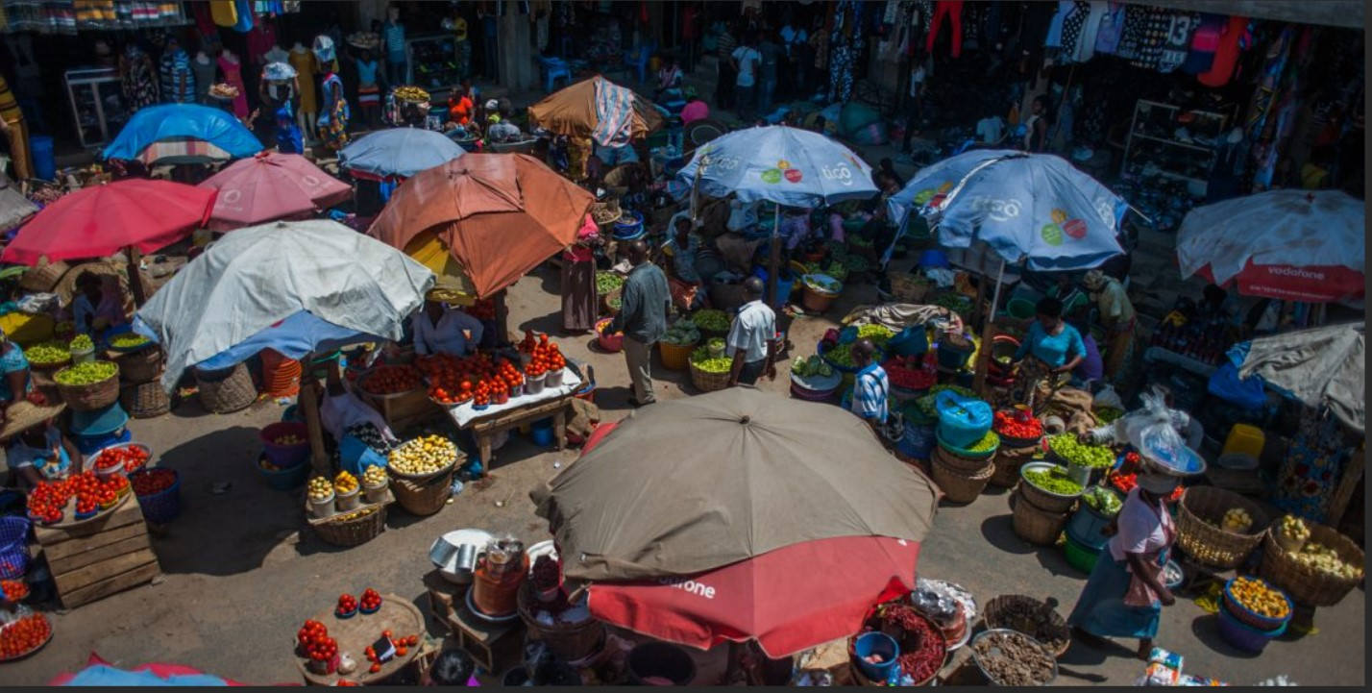
Conclusion
The informal economy has moved in and is here to stay
and will continue to grow.

Slide 15
Conclusion ctd
Let’s give it a seat at the table.
Let’s Recognize and support its growth and development through the development and implementation of social security policies that speak to its needs.

Slide 16
Conclusion
There is no one solution for extending coverage. As a result, various governments have instigated a range of approaches and measures adapted to the national context to extend coverage. Strategies are not mutually exclusive but are more nuanced in practice. Many countries have extended social protection coverage using a combination of measures and approaches rather than pursuing a single method. Interventions show success particularly when they are undertaken within an integrated or comprehensive strategy or policy framework.
Strong social dialogue is essential for the effectiveness of policies –with the participation of employers and workers organizations including representation from the informal economy- “Nothing for them without them.”

Slide 17
Let's make social security a reality for the informal economy through policies that are Responsive, Inclusive and Sustainable. #Just Transition #Leave no one behind Thank You!!!

