Slide 1
"The Role of Social Security in South Africa's Just Transition,"
What makes the Just Transition Just? definition of the minimum Decent Standard of Living for all South Africans
Notes:
The whole talk should be under 10 minutes.

Slide 2
Changing definitions of a Just Transition
The term “Just Transition” was originally developed by trade unions in the United States in the 70s
It has since been adopted, expanded and co opted by a wide range of different actors.
The term can be classified according to
the scope of transition,
the depth of transition,
participation and inclusion in the transition.
Notes:
“Narrower definitions tend to have a specific focus on protecting workers (and sometimes communities) facing the burden of decarbonisation within fossil fuel industries. Others, however, take a much broader approach, addressing the need for the just transition principles to be applied across the economy and society as a whole. In terms of depth of the transition, some view the transition only affecting a certain level of the economy, restricted to a certain sector or the types of changes required. This applies particularly to energy, which has been a significant area of focus due to its high level of emissions. This transition is generally viewed as requiring a move away from fossil fuel to renewable energy production, often connected to ideas of a transition towards a ‘green’ economy. On the other end of the spectrum, there are those who advocate for a much deeper and more holistic transition, which ultimately results in the structural transformation of our economies (across sectors and scales) and society.”

Slide 3
The current provisions
In a broad definition austerity has resulted in an attack on many basic providers of social security in South Africa.
In a narrow sense there is a negligible fraction of the JET-IP devoted to affected communities from the closure of fossil fuel value chains.
Further renewable investments have seen limited (and often exaggerated) benefit to local communities. (Malope, 2022)

Slide 4
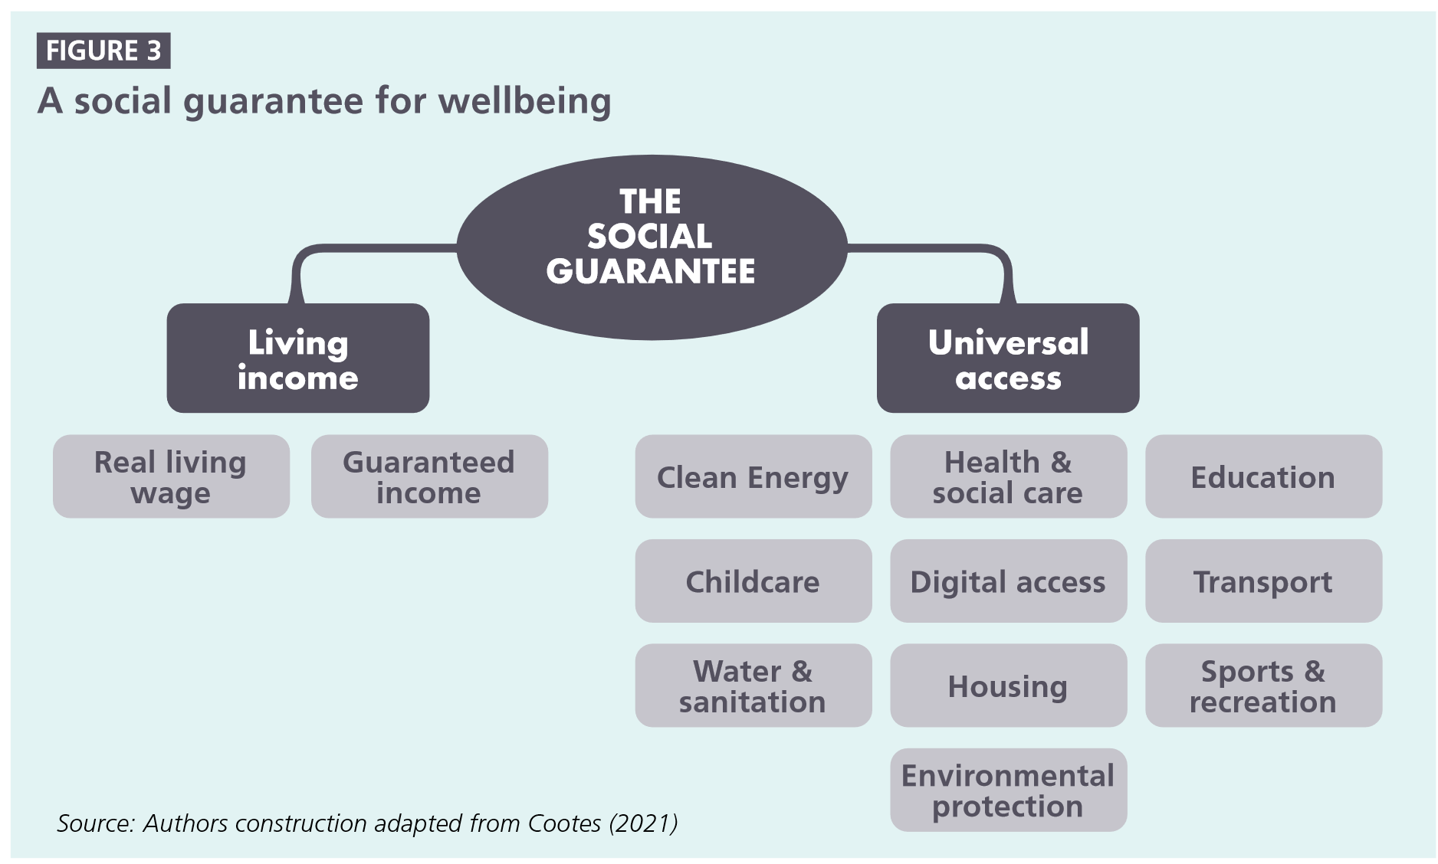

Slide 5
Principles
1.. Caring rights based economy:
2. Economy-wide transition for low carbon and climate resilient economy:
3. Transformation of ownership, distribution and access to resources:
4. Democratic, empowering and context specific:
5. Address power using an intersectional feminist lense:
6. Demand restorative justice:

Slide 6
Measures
1. Social policy for low carbon, climate resilient universal public services and social protection:
2. Green industrial policy:
3. Labour policy for green decent work:
4. Equitable land and ownership reform:
5. Macroeconomic policy:

Slide 7
Zooming in on Social Policy
Care
Sustainable Public Infrastructure Services
Social Protection

Slide 8
More “Justice” More “Transition”
Capital is unable to build the actual political will to ensure an adequate transition.
The transition is slowed down not by attempts to make it more just, but by attempts to retain unequal power over resources. Maintaining high returns for dirty finance, etc.
It’s not a trade off its a complement. The more justice we have, the more of a transition we get.

